Slide 1

Optimizing Citi Bike Operations:
The 65-80°F Strategy
Strategic Recommendations for Fleet Management & System Balance
Group #3 - Data Divas
Team Members: Molly Meyers, Isaiah Pihlstrom, Dario Garcia, Sidney Dobbins, Terry Qi, Yang Hu
TO 550
February 14, 2026
Notes:
@Dario

Slide 2









Core Narrative
Operational readiness within the 65° to 80°F
temperature range is critical to maintaining system balance and maximizing fleet utilization efficiency.
Why This Matters
Front Line Operations Manager
Peak Ridership Windows
Station Pressure Points
Ridership consistently peaks in this temp range. Without proactive positioning, stations fail.
High demand causes rapid stockouts (empty stations) or dockouts (full stations), disrupting the network.
Primary Audience
Accountable for daily fleet performance & station reliability
Rebalancing Logistics
Maintenance Coordination
Manages rebalancing logistics & truck routing
Reactive emergency redistribution is costly and inefficient compared to planned staging.
Ensuring fleet health before peak demand days prevents compounding operational failures.
Coordinates maintenance response teams
Ensures bikes are available where riders need them
Strategic Call to Action
When forecasts project 65-80°F: Pre-position bikes at high-traffic stations, adjust rebalancing schedules, and monitor net flow imbalances in real time.
TO 550
Citi Bike Operations Strategy • Group #3
Notes:
@Dario

Slide 3










The Temperature Trigger: Problem, Insight & Impact
The Problem
Key Insight
The Impact
Current bike staging is optimized for corporate commutes but fails to adapt to weather-driven demand shifts.
Rider behavior and trip volume shift dramatically when temperatures hit a specific optimal window.
Failing to operationalize this insight leads to compounding system failures during peak revenue periods.
Missed revenue from thousands of potential casual trips
Demand concentrated in corporate hubs (Midtown/FiDi)
65° – 80°F
Stockouts at leisure stations & Dockouts at hubs
High-potential leisure routes are underserved
The Critical Trigger Zone
Increased emergency rebalancing costs
Static rebalancing may not account for real-time weather triggers
Significant surge in casual ridership
Geographic shift from business districts to parks & waterfronts
System instability erodes customer trust
TO 550
Citi Bike Operations Strategy • Group #3
Notes:
@Terry

Slide 4
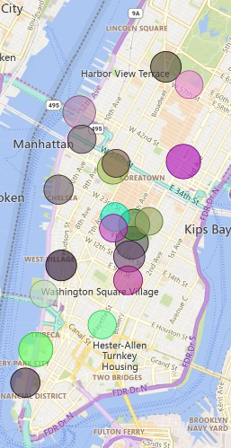
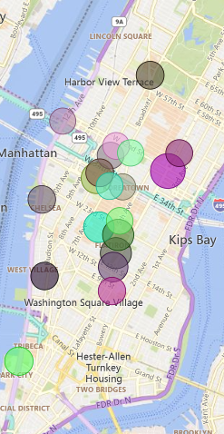





System Pain Points & Operational Challenges
Without weather-adaptive strategies, the network faces compounding operational failures during critical revenue windows.
1. Geographic Supply/Demand Mismatch
2. High Cost of Reactive Rebalancing
Current staging strategy is static and focused heavily on Midtown Manhattan.
Reliance on emergency redistributions when stations hit critical levels.
Warm weather (65-80°F) shifts demand rapidly to underserved recreational routes near
Inefficient crew deployment due to lack of weather-based forecasting triggers.
Operational Gap
Financial Impact
Fleet trapped in business districts while demand surges in parks
Increased labor hours & fuel costs per rebalanced bike
Top 20 stations by rides in peak (left) and non-peak (right) weather
TO 550
Citi Bike Operations Strategy • Group #3
Notes:
@Terry

Slide 5

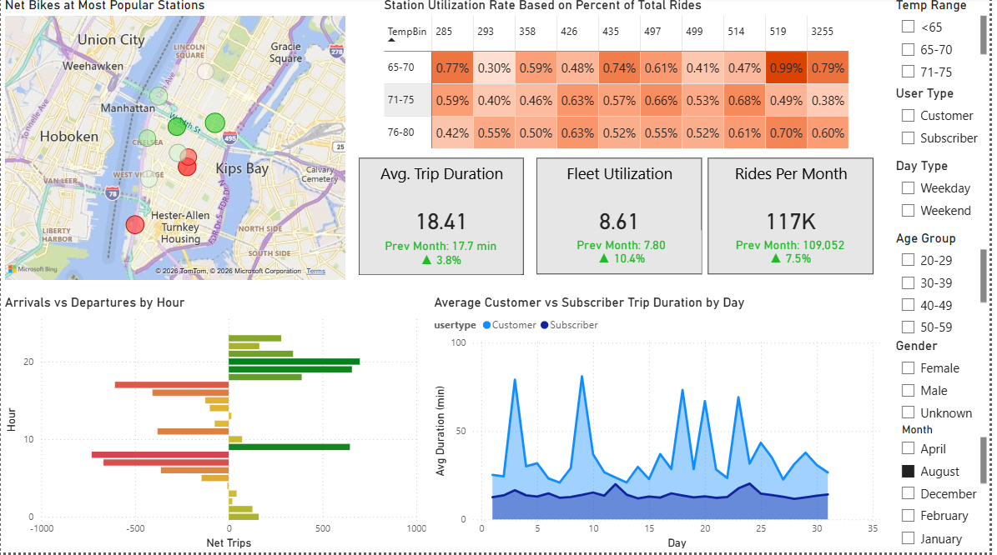





Power BI Dashboard: System Overview
Citi Bike Analytics
Geographic Demand
Top 25 stations are heavily concentrated in Lower Manhattan corporate hubs, driving morning/evening peaks.
User Mix
Core base is strong: 80% Subscribers (Commuters) vs. 20% Customers (Tourists/Leisure).
Opportunity Zones
A second shortage window in the afternoon, as casual and leisure trips increase beyond the morning commute peak.
TO 550
Citi Bike Operations Strategy • Group #3
Notes:
@Molly

Slide 6

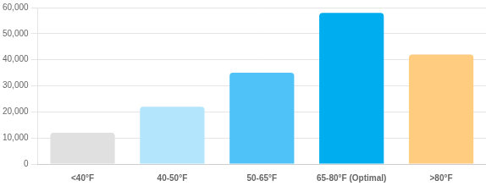

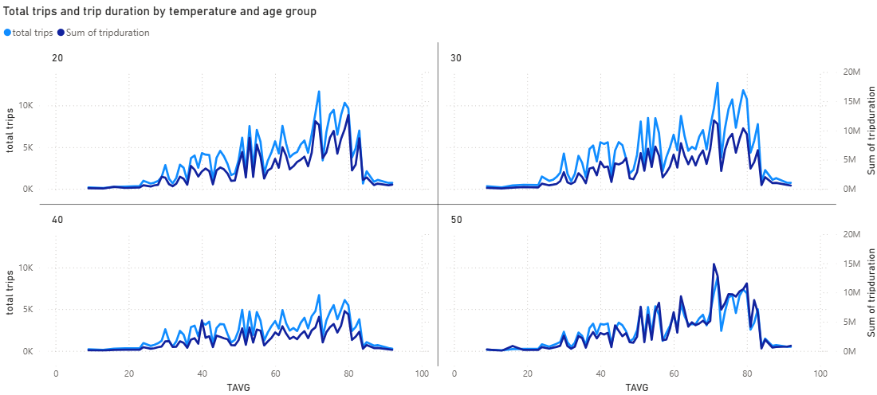
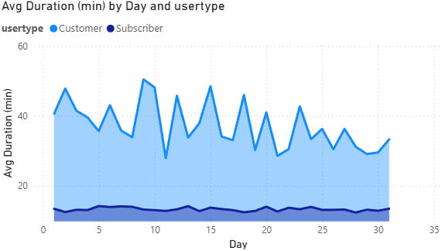

Data-Driven Insights: Temperature Impact
Ridership vs. Temperature
Average Daily Trips by Temperature Range
Peak: 72°F
Utilization rates spike significantly when temperatures enter the 65–80°F optimal window.
72°F identified as the peak popularity temperature for casual riders (customers).
Outside this window, casual ridership drops by over 40%.
Rider Behavior Shifts
Longer Trips: Average duration increases by 15-20% in warm weather (leisure riding).
Younger Demographic: Under-30 riders become more prevalent during optimal days.
Route Shift: Traffic moves from crosstown commutes to parks and waterfront loops.
Time Patterns
Weekdays: Sharp peaks at 8 AM and 5 PM (Corporate Hubs).
Weekends: Bell curve distribution peaking midday (12 PM - 4 PM).
TO 550
Citi Bike Operations Strategy • Group #3
Notes:
@Molly

Slide 7


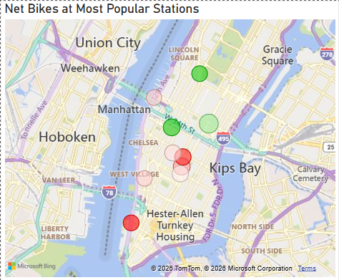

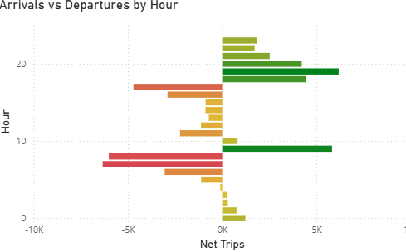




Recommendation #1: Proactive Fleet Staging
Activation Trigger
Core Strategy
65°–80°F
Pre-position bike inventory from corporate hubs to high-potential leisure and recreational routes ahead of forecasted demand spikes.
Forecasted Weather Window
Implementation Plan
1
Deploy Before Afternoon Peak (12-2 PM)
Shift inventory during the midday lull to ensure stations are stocked before the 3 PM - 7 PM warm weather surge.
2
Target High-Potential Leisure Zones
Prioritize stations near Central Park, Hudson River Greenway, and Brooklyn Bridge Park.
3
Monitor Real-Time Capacity
Use dashboard alerts to track net flow at staging locations to prevent overstocking.
Corporate Hubs
Staging Move
Leisure Routes
TO 550
Citi Bike Operations Strategy • Group #3
Notes:
@Yang

Slide 8


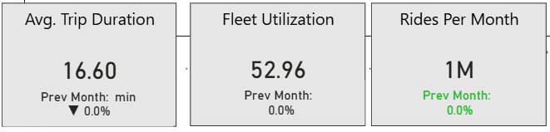
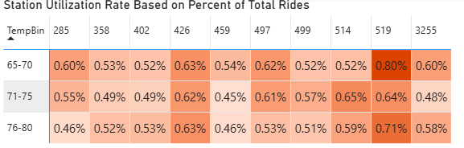



Recommendation #2: Dynamic Rebalancing Strategy
Core Strategy
Critical Threshold
Implement weather-integrated real-time rebalancing operations to prioritize high-pressure stations and optimize crew routing.
95%
Fleet Utilization During Peak Usage Temp/Time
Implementation Plan
1
Integrate Weather API
Push live weather alerts directly to field crew mobile dashboards to anticipate 65–80°F windows.
2
Prioritize High-Pressure Zones
Minimize out-of-service fleet. Deploy rapid-repair teams and increase check frequency during 65–80°F windows.
3
Maximize Peak Availability
Increase rebalancing frequency and crew deployment in advance of days with optimal forecast.
Weather Forecast
Crew Dashboard
Optimized Routing
TO 550
Citi Bike Operations Strategy • Group #3
Notes:
@Sidney

Slide 9










Implementation Plan & Success Metrics
2-Month Pilot Launch (Spring Season)
Week 1-2
Week 3-4
Week 5-8
Post-Pilot
System Integration
Staff Training
Live Pilot
Review & Scale
Weather API setup & Crew dashboard updates
New routing protocols & staging procedures
Active dynamic rebalancing in 65-80°F windows
Performance analysis & full rollout decision
Key Performance Indicators (KPIs)
+15%
-30%
-25%
High
Lift in Casual Ridership
Stockout / Dockout Incidents
Emergency Rebalancing Costs
Casual-to-Subscriber Conversion
Primary Target
Service Reliability
Operational Efficiency
Long-Term Growth
Real-Time Dashboard
Weekly Ops Reviews
Convert casual riders to annual subscribers, increasing lifetime customer value.
Live tracking of net bikes per station stability
Performance evaluation with operations team
LONG-TERM GOAL
TO 550
Citi Bike Operations Strategy • Group #3

Slide 10









Recommendation #3: Seasonal Maintenance Optimization
Core Strategy
Optimization Target
Align heavy maintenance cycles with seasonal demand patterns to maximize fleet availability during revenue-generating windows.
95%+
Fleet Availability in Peak Season
Implementation Plan
Expected Outcomes
1
Winter: Deep Maintenance (Nov–Feb)
Significantly higher bike availability during peak demand windows.
Shift heavy fleet overhauls and infrastructure upgrades to low-demand months. Clear repair backlogs before March 1st.
2
Spring/Summer: Rapid Response (Mar–Oct)
Improved system reliability and rider experience.
Minimize out-of-service fleet. Deploy rapid-repair teams and increase check frequency during 65–80°F windows.
Reduced maintenance backlog during high-revenue periods.
3
Maximize Peak Availability
Ensure 100% of serviceable bikes are deployed to stations ahead of the spring surge.
More efficient utilization of mechanics during winter downtime.
Winter
Spring/Summer
Result
Heavy Repairs
Max Deployment
High Uptime
TO 550
Citi Bike Operations Strategy • Group #3

Slide 11








Appendix: Sources & References
Primary Data Sources
Analytical Framework & Artifacts
Citi Bike Monthly Operating Report (Dec 2019)
TO 550 Revised Narrative
Strategic positioning, core problem statement, and call to action definition.
864
12,800
149,740
Active Stations
Total Fleet Size
Annual Members
TO550 Final Presentation Visuals
975,203
90,502
$2.3M
Power BI dashboard visuals, demographic breakdowns, and station utilization maps.
Total Trips
Rebalancing Actions
Monthly Revenue
HW#5: Storyboard Strategic Framework
Storyline development, "Temperature Trigger" concept, and operational pain point mapping.
Citi Bike Trip Data 2019
Complete trip history dataset used for temporal and spatial analysis.
Key variables: Start/End Station, Duration, User Type (Subscriber/Casual), Gender, Birth Year.
HW#4: Target Persona Analysis
Stakeholder identification (Front Line Ops Manager) and user segmentation.
Group #3 — Data Divas
TO 550
Molly Meyers • Isaiah Pihlstrom • Dario Garcia • Sidney Dobbins • Terry Qi • Yang Hu
Storytelling & Data Visualization

